Slide 1
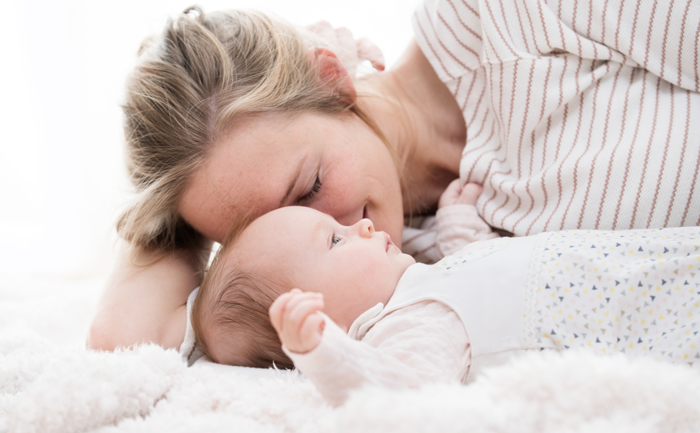

Medibino
by Kluba Medical
The smart baby brand to simplify parenting and care

Slide 2
Background MedibinoNeo
Positional Head Deformations
Characteristics, development and frequency

Slide 3

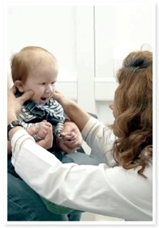
Effective prevention of positional head deformities
Developed by a specialist
Dr. Dr. Susanne Kluba
Dr. Dr. Susanne Kluba is an oral and maxillofacial surgeon with a focus on treatment and research in the field of positional head deformities.
She is the founder and head of the special consultation for positional head deformities at the University Hospital in Tübingen.
She has been caring for affected infants and their families for more than 15 years.
She has developed the Medibino baby head protection in the course of her clinical work with affected families.

Slide 4
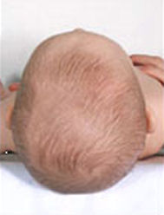
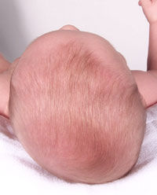
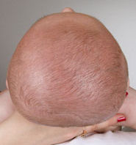
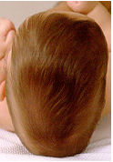
Positional head deformities in infants
Types of head deformities
normal head shape
Lateral flattening
Plagiocephaly
Flattening of the
backhead
Brachycephaly
Scaphocephaly

Slide 5
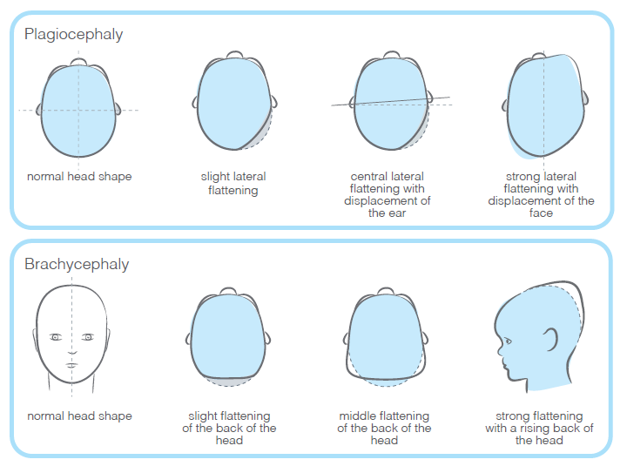
Positional head deformities in infants
Development of head deformities
Positional deformities may be clinically manifested by a skewed skull (plagiocephaly) with a unilateral occipital flattening as the main feature or a short skull (brachycephaly) with bilateral occipital flattening.
Mixed forms are common. Furthermore, an ear axis displacement and facial asymmetries can occur.
The malformations can be very conspicuous and pronounced and are decisive for the parents search for clarification and counselling.
Development plagiocephalus, brachycephalus: based on Argenta LC. Clinical classification of postional plagiocephaly. J craniofac. Surg. 2004;3:368-72

Slide 6
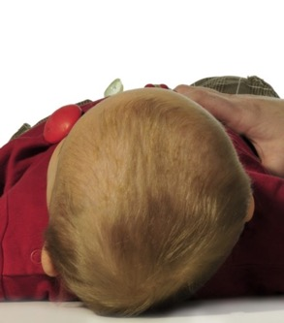
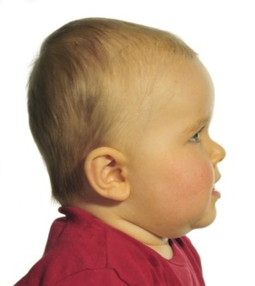
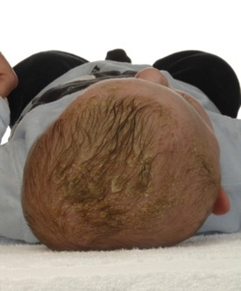
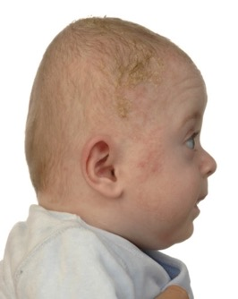
Positional head deformities in infants
Exemplary clinical manifestations
Clinical expression plagiocephalus
Clinical expression of brachycephalus

Slide 7
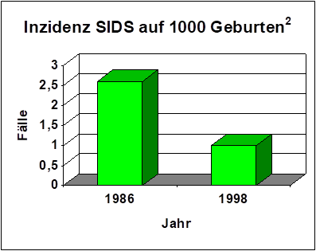
Positional head deformities in infants
Frequency of head deformities
Since 1992: Recommendation of supine position of infants¹
Senkung der Inzidenz des plötzlichen Kindstodes (SIDS)
Reduction in the incidence of sudden infant death syndrome (SIDS)^{3,4,5}
Incidence:
  1:300 (1974)
  1: 60 (1996)
  1: 5 (2007)
  1: 5 – 1: 2,5 (2016)
Incidence of SIDS per 1000 births²
cases
year
¹ AAP Task Force on Infant Positioning and SIDS. Pediatrics 1992; 89:1120-6
² Paris et al.Risk factors for sudden infant death syndrome: changes associated with sleep position recommendations.J Pediatr 2001;139:771-7
³ Dumm PM. Congenital sternomastoid torticollis: an intrauterine postural deformity. Arch Dis Child 1974;49:824-5
⁴ Argenta et al.An increase in infant cranial deformity with supine sleeping position J Craniofac Surg 1996;7:5-11
⁵ Matarazzo CG, Pinto FCG, Peccin MS, Schreen G. Orthotic treatment of cranial asymmetries: Comparison between early and late interventions. J Prosthet
Orthot. 2016;28(1):15-22. http://dx.doi.org/10.1097/JPO.0000000000000084.

Slide 8
Positional head deformities in infants
Risk factors
Prenatal factors
Male sex
Multiple pregnancy
Intrauterine constraints
Perinatal factors
Obstetric measures
High birth weight
Prematurity
Large head circumference
Postnatal factors
Supine positioning
Restricted head movement, torticollis
Side preference
Bottle feeding without change of position
Little activity
Little "tummy time

Slide 9
Positional head deformities
Focus on prevention

Slide 10
Effective prevention of positional head deformities
Focus on prevention
To prevent and alleviate head deformity, experts recommend mobility promotion and pressure-relieving positioning
These measures are:
Carrying babies in slings or baby carriers
breastfeeding or bottle-feeding in alternate positions
Positioning the baby bed with different orientation to the window
making contact with the infant from different sides, and, under observation, promoting motor development in the prone position ("tummy time") during the infant's waking hours
Furthermore, the German Society for Surgery, together with the German Society for Paediatric Surgery, among others, recommends special positioning pillows as a preventive measure, which allow the back of the head to float freely.

Slide 11
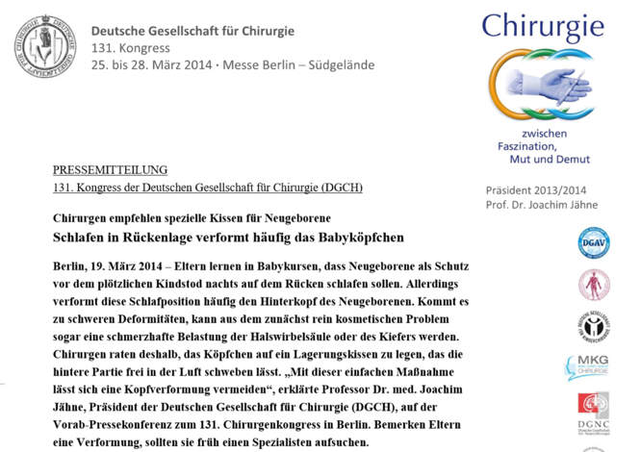
Pressure-relieving positioning pillows recommended
German Society for Surgery
For the prevention of cranial deformities, positioning pillows are recommended that allow the back of the head to float freely

Slide 12
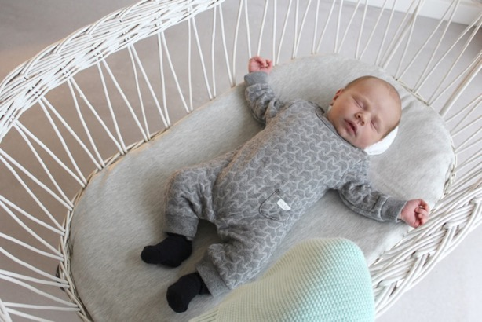
All things spring from a small beginning
Marcus Tullius Cicero

Slide 13
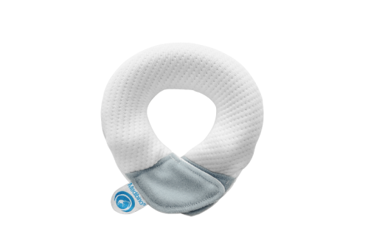

Medibino – Patented Medical Device
To prevent position-related head deformations
The first positioning pillow that grows with you - no need to buy more, no need to replug
The first positioning pillow that is not a pillow and meets the specifications for safe baby sleep. The ring has a small surface area and allows the head to float freely.
Patented medical device developed by a specialist for head deformations, which can be used both prophylactically and therapeutically
Made in Europe with a cover made of high-quality, certified materials

Slide 14
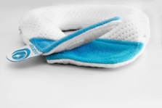
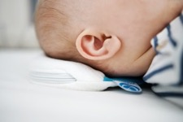
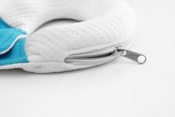
Medibino – Patented Medical Device
Unique Features
Adjustable size
Can be individually adjusted to the size of the baby's head over the duration of use
Flexible and safe
Your baby's daily companion for healthy and even growth
Small and handy
Optimum use in the baby's environment, even in their pram and baby seat
Changeable covers
Easy cleaning and care - available in individual designs

Slide 15
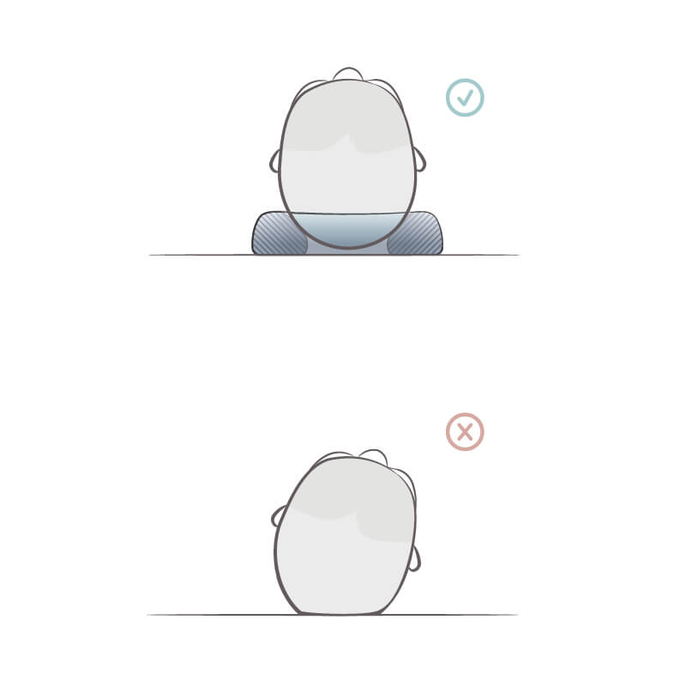
Medibino - Patented medical product
Mode of action
With regular and early use, the Medibino supports the maintenance of a healthy and even head shape.
The ergonomic shape and individual size adjustability allow the infant's head to grow safely without strain.
The sensitive back of the infant's head does not rest on the base due to the positioning in the hollow of the ring - the pressure load and danger of a flattened or crooked head is thus prevented in the best possible way.
Recommended duration of use: From the first day until the child begins to turn regularly on its own and becomes mobile - the Medibino can then be used for longer sleep phases in the supine position.
In consultation with the paediatrician / physiotherapist, the Medibino can also be used to alleviate existing head deformities.

Slide 16
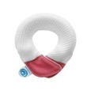
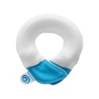
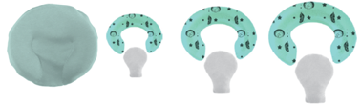
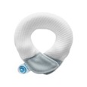
Medibino – Patented Medical Device
from homecare to clinic
Medibino – the baby head protector
Prophylactic and therapeutical support against head deformations in newborns
Developed by a surgeon working with affected babys and their families
Approval according to medical device directive 93/42/EEC in Q4 2018
Certified and tested material
Produced in Europe
Medibino – Positioning System
Clinical positioning system for the application in perinatal centers and the neonatal ward for premature and newborns
CE mark since June 2022
Helps to prevent head deformations in prematures and to stabilize the midline position or during therapeutical interventions

Slide 17
Developed according to the latest medical standards
Developed with leading German clinics and recommended by midwives

Slide 18











Developed and Approved in A Clinical Setting
Partnership with leading neonatal clinics and premature initiatives
Invention and patent of the Medibino and MedibinoNEO concept
Senior Physician
Dr.med. Juliane Tautz
Chief Physician
Prof. Dr. med. Thomas Höhn
Product Development in cooperation with leading clinics and premature initiatives
Conception & Testing
Dr. med Dariusz Michna
Dr. med. Wilfried Schenk

Slide 19
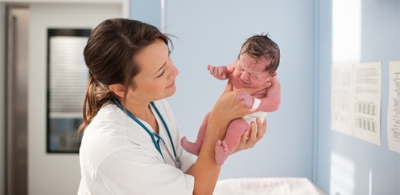
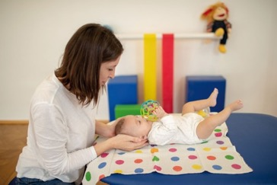
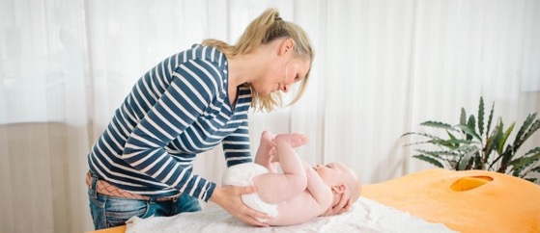
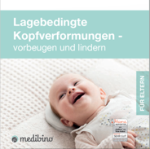
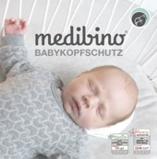
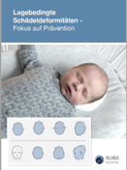
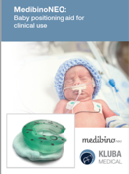
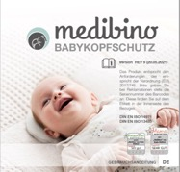
Product Ambassadors
Midwives, physiotherapists and osteopaths recommend the Medibino
More than 1.000 midwives, paediatric physiotherapist and paediatric osteopath work as ambassadors for our products and use our information materials to educate parents about positional head deformities.

Slide 20
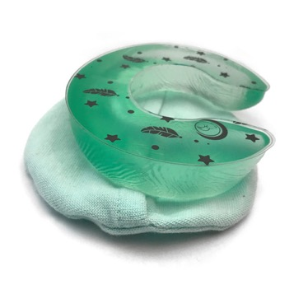
MedibinoNEO - head positioning system for premature and newborn babies for clinical use

Slide 21
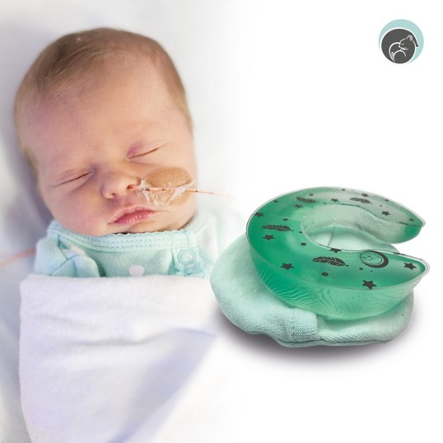
Clinical Demand
MedibinoNEO Head Positioning System
For the pressure-relieving positioning of premature babies and infants during a long stay in the neonatal intensive care unit as well as in the maternity ward to inform parents about measures to prevent cranial deformities
For positioning in 30° elevation and for stabilisation of the central head position in asphyxia and, if required, for prevention of intraventricular haemorrhages (cerebral haemorrhage)
To stabilise the head during necessary interventions

Slide 22

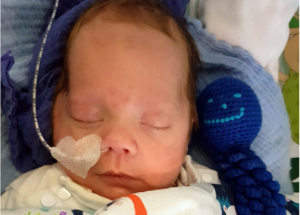

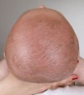

Positioning of Premature Babies
Increased occurrence of cranial deformities
Etiology:
Premature babies have even softer skull bones than newborns born at maturity, wear brackets for respiratory equipment on their heads and therefore are even more predisposed to skull deformities.
With the premature baby's preferred body position, the initial deformation is further intensified.
Normal head shape
Plagiocephaly
Brachycephaly
Dolichocephaly

Slide 23
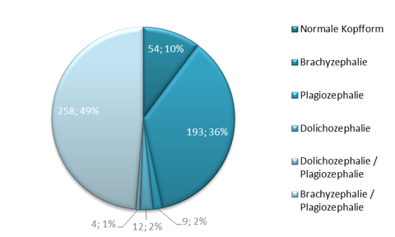
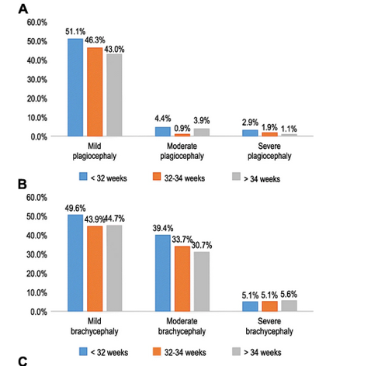
Positioning of Premature Babies
Increased occurrence of cranial deformities
The incidence of cranial deformities in premature babies is 51.1% for plagiocephaly; 85.1% for brachycephaly and 3% for dolichocephaly.¹
Yang, W., Chen, J., Shen, W. et al. Prevalence of positional skull deformities in 530 premature infants with a corrected age of up to 6 months: a multicenter study. BMC Pediatr 19, 520 (2019).
Skull deformities caused by the stay in hospital should be counteracted prophylactically

Slide 24
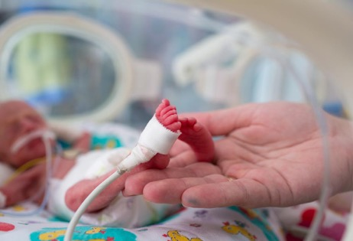
Positioning of Premature Babies
Back support: Clinical standard
Supine and central head positioning are the clinical standard to prevent intraventricular haemorrhages (IVH), especially for premature infants <26 weeks within the first 72 hours of life
the premature babies are subsequently positioned in different positions
When intraventricular haemorrhages occur, the head should be positioned in the middle position¹
For neonatal asphyxia, the guideline callls for upper body elevation and a 72-hour medial position of the head²
¹Dagmar Pastry, Heike Jipp: NEOnatological and paediatric intensive care and anaesthesia: Practical Guide
²024/023 S2k Guideline: Treatment of neonatal asphyxia with special emphasis on therapeutic hypothermia

Slide 25
Prevention of Intraventricular Haemorrhages (IVH)
Controversial research situation
A review of 48 premature babies showed insufficient evidence on the influence of storage on cerebral oxygenation and haemodynamics and the incidence of IVH¹
A meta-analysis (290 premature babies) showed no effect of the position on the occurrence of intraventricular haemorrhage, but a reduced mortality for supine position with central head positioning, which, however, may also caused by an elevation of 30°²
A study of 23 premature babies showed no positive influence of the supine position compared to the prone position on the oxygenation of cerebral tissue and cerebral haemodynamics³
¹de Bijl-Marcus KA, Brouwer AJ, de Vries LS, van Wezel-Meijler G. The Effect of Head Positioning and Head Tilting on the Incidence of Intraventricular Hemorrhage in Very Preterm Infants: A Systematic Review. NEOnatology. 2017;111(3):267-279
²Romantsik O, Calevo MG, Bruschettini M. Head midline position for preventing the occurrence or extension of germinal matrix-intraventricular haemorrhage in preterm infants. Cochrane Database Syst Rev. 2020 Jul 7;7(7):CD012362
³Spengler D, Loewe E, Krause MF. Supine vs. Prone Position With Turn of the Head Does Not Affect Cerebral Perfusion and Oxygenation in Stable Preterm Infants ≤32 Weeks Gestational Age. Front Physiol. 2018 Nov 22;9:1664.

Slide 26
Prevention of Intraventricular Haemorrhages (IVH)
Controversial research situation
A retrospective study in Kiel showed that by introducing a catalogue of measures (<1500g: strict supine position and central head positioning for 72 hours) a significant reduction by half of mild to moderate (not severe) intraventricular haemorrhages (Hohmann MM, 2016) could be achieved
Patra et al. showed that IVH is the most common cause of psychomotor and intellectual disabilities, even if it is only a slight bleeding¹
¹Patra K, Wilson-Costello D, Taylor H, Mercuri N, Minich N, Hack M. 2006. Grades I-II intraventricular hemorrhage in extremely low birth weight infants: effects on neurodevelopment. J Pediatr pp. 149:169-73)
The retrospective analysis cannot exclude further influences, but suggests that long-term effects can be reduced by positioning in supine position with central head positioning

Slide 27
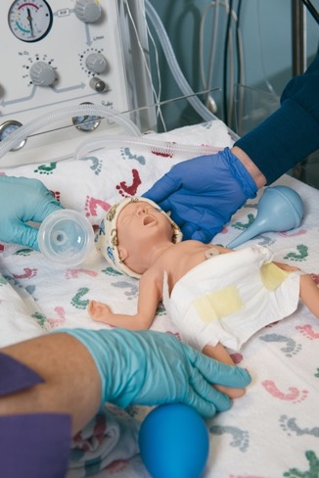
Positioning of Premature Babies
Interventions
Many interventions require the premature baby to be placed in a stable central position, including:
  Placement of a stomach tube
  Respiratory distress syndrome therapy (suction, surfactant administration, ventilation)

Slide 28
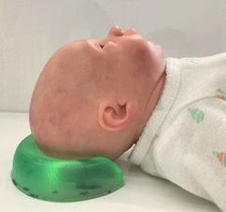
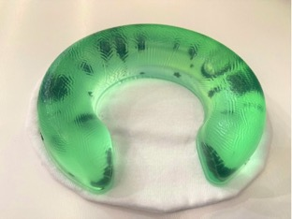
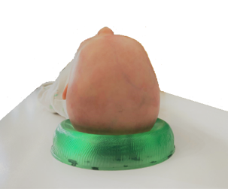
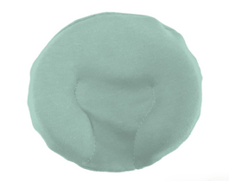
Development of a product answering the clinical demands
MedibinoNEO
Assists the midline position
Easy cleaning with desinfection wipes
Three sizes and additional inner cushion available
Child-friendly
design
Disposable covers
Reusable covers for less waste
Durable (usage up to 12 months)
Prevention of head deformities
Biocompatibility tested

Slide 29
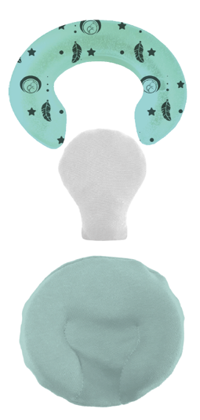
Components of the MedibinoNEO Head Positioning System
Soft gel ring
Available in sizes S, M, L
Size L: 130 mm x 110 mm x 25 mm
Size M: 110 mm x 95 mm x 22 mm
Size S: 90 mm x 80 mm x 18 mm
Non-sterile, wipe disinfectable
Inner cushion made of 2.5-layer laminate, SMPTX 118g/sq m
Available in sizes S, M, L to match the gel ring
Waterproof and wipe disinfectable
Filled with soft gel balls
Cotton cover
Available in sizes S, M, L to match the gel ring
Hotel closure with insert for ring and inner cushion
Washable at 60 °C
All components are also available separately

Slide 30
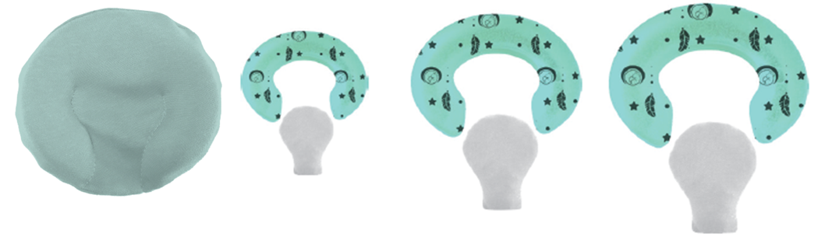
MedibinoNEO Head Positioning System - Sizes
MedibinoNEO size S for premature babies up to
800 g
Dimensions: 90 mm x 80 mm x 18 mm
MedibinoNEO size M for premature babies between approx. 800g and 2000g
Dimensions: 110 mm x 95 mm x 22 mm
MedibinoNEO size L for premature babies over 2000g and infants
Dimensions: 130 mm x 110 mm x 25 mm

Slide 31

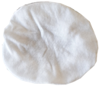
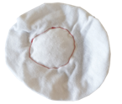
Components & Features MedibinoNEO
Helps to minimise head deformation and skin abrasion by relieving pressure and promoting correct positioning
Three sizes and different disposable and multi-weave covers guarantee flexible use according to the needs of the premature baby unit
Gel ring, inner cussion and cotton cover with hotel closure – multi use
Assists in stabilising the midline position of the head
Fresh colours guarantee retrieval and provide a child-friendly design
Disposable soft cover
Tested gel ring is free of mould and bacteria, easy to clean and durable (usage up to 12 months)
Inner cushion filled with gel balls provides additional stability when needed
Disposable soft cover WITH gel ball depot included

Slide 32



 | Tortle Midliner | Children’s Medical Ventures Gel-E-Donut | DandleLION Medical / Sandbox Medical Jelly Pads | Medibino NEO
Different Sizes
Provides midline stabilisation and pressure relief at the same time
Supports back and side position
Easy daily cleaning during the NICU stay
Disposable covers available
No hindrance to own movement
Multiple use possible
Easy repositioning
Brackets for medical tubes or devices
prevents new pressure points for skin ulcers or the development of a turricephalus
ü
ü
ü
ü
X
X
X
ü
Comparison with other Systems (1/2)
ü
X
X
ü
X
ü
ü
ü
X
ü
ü
ü
X
ü
ü
ü
ü
X
X
ü
X
ü
ü
ü
ü
X
X
X
X
ü
ü
ü

Slide 33
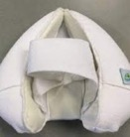




Comparison with other systems (2/2)
Products | Challenges
Tortle Midliner | Extensive adjustment to the product necessary to change the positioning No pressure relief of the back of the head in the mid-head position Restricted freedom of movement due to fixation of the head and pressure on the shoulders Fixation with tape favours elongated skull shape (turricephalus) and skin ulcers on the forehead Product must be washed and dried completely No disposable covers available
Jelly Pads / Jelly Donuts | Unstable positioning Does not support midline stabilisation Non reuseable (Use only per patient > leads to high volume of waste and high costs) Do not meet the recommendation of the German Surgery Society with a contact free rear part of the head

Slide 34
Voice of the customer
What the experts and users say about our Medibino Babyheadguard for newborns

Slide 35
Expert Opinion
What our Midwives say
Midwives test campaign 2021
“If I were to recommend a head protector it would be this one!”
Midwives test campaign 2021
“The design and the really soft foam core provide a cosy support for the child. It is also very easy to clean, which I like.”
Midwives test campaign 2021
“I found it very appealing that the head protection is size-adjustable. The material used is very soft and comfortable and I like that the packaging is made of fabric and not plastic.”
Midwives test campaign 2021
“Simple, flexible and safe method to prevent and alleviate bearing-related head deformities.”
Midwives test campaign 2021
“A natural and gentle head growth is definitely given by this product. Medibino baby head protection can also be used to alleviate existing head deformities, visible changes after just a few days.”
Midwives test campaign 2021
“The baby's mother was very pleased and the head shape has also improved.”

Slide 36
Medibino / MedibinoNEO
Further Arguments

Slide 37
Medibino
Safe baby sleep / Recommendation of the German Society
for Surgery and Paediatric Surgery
The Medibino is the product that best fulfils the requirements for safe baby sleep AND the recommendation of the German Society for Surgery.
  The recommendations for safe sleeping are that no objects of any kind should be placed in the bed, especially large pillows because of the risk of overheating and suffocation.
  At the same time, however, the German Society for Surgery, together with the German Society for Paediatric Surgery, recommends that infants should be placed on special pillows that allow the back of the head to float freely during sleep and in the supine position to prevent head deformities. Medibino is the only positioning pillow that allows free floating.
    Medibino is deliberately designed not as a large-volume pillow but as a positioning ring, so that the risk of overheating and anaemia is minimised by the small surface area; at the same time, it meets the specifications of the German Society for Surgery because it allows the back of the head to float freely. Of the available products, Medibino is the one that best meets the requirements. Kluba Medical holds a patent on its properties.

Slide 38
MedibinoNEO
Made in Europe
The Medibino is made of certified materials in Europe
All materials meet the biocompatibility criteria of the Medical Device Directive according to the ISO 10993-5 standard.

Slide 39
Medibino
Developed in the clinic according to the latest scientific standards
Dr Dr Susanne Kluba is an oral and maxillofacial surgeon and founder of Kluba Medical GmbH
  For many years, her treatment and research focus has been on positional head deformities.
  She is the founder and director of the special consultation for positional head deformities at the University Hospital of Tübingen and has been caring for affected infants and their families there for more than 15 years.
  The concept of the Medibino was developed within the framework of this clinical work. Step by step, the concept was further developed in application and in consultation with the users. Motivated by the parents of her little patients, Dr. Dr. Kluba has further developed the Medibino into a medical product so that it can benefit all infants.
  The product and previous prototypes have been used successfully for many years at the University Hospital in Tübingen.
  The MedibinoNeo was co-developed with the NICU-teams of 3 leading hospitals in Germany.

Slide 40
Medibino
Patented Medical Product
    The Medibino is a patented approved medical device according to the European Medical Devices Regulation (MDR) and is registered as such with the German Federal Institute for Drugs and Medical Devices and the EUDAMED. The district government has inspected the product and the technical documentation, as well as all processes, and confirmed conformity with the Medical Devices Act.

Slide 41

MedibinoNEO
by Kluba Medical
Short instructions MedibinoNEO

Slide 42
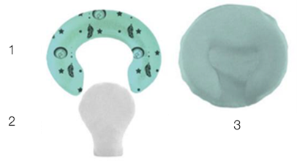
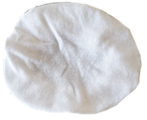

Product and Components
MedibinoNEO® consists of different components that can be used in different variations.
Base system
The basic product consists of three components: A support ring, an inner cushion and an outer protective cover made of fabric. The cover of the MedibinoNEO® support ring can be removed by means of a hotel closure and the inner core can be taken out.
The use of the inner cushion is optional.
Use without inner cushion: Without inner cushion, the back of the head floats freely as recommended and grows out round without counterpressure from below, this is ideal for long lying periods for normal storage in the incubator.
Use with inner cushion: This option is additional if the primary aim is to keep the head in the mid-head position and the head is to be positioned lower in the ring. The inner cushion continues to provide pressure relief in this position. It can also be used for height adjustment.
Further covers
MedibinoNEO® disposable cover cotton knit - colour coded WITHOUT soft granules
The Medibino Cover in cotton knit is a cover for single use. It can be used together with the cotton cover with hotel closure to protect it. Alternatively, it can be placed directly over the ring and (optional) the inner cushion.
MedibinoNEO® disposable cover cotton knit - colour coded WITH soft granules
The Medibino cover made of cotton knit WITH soft granules is a cover for single use. As it already contains a soft granulate depot, it is used without the inner pillow and is simply slipped over the head ring.

Slide 43
MedibinoNEO Head Positioning System - Sizes
MedibinoNEO size S for premature babies up to
800 g
Dimensions: 90 mm x 80 mm x 18 mm
MedibinoNEO size M for premature babies between approx. 800g and 2000g
Dimensions: 110 mm x 95 mm x 22 mm
MedibinoNEO size L for premature babies over 2000g and infants
Dimensions: 130 mm x 110 mm x 25 mm

Slide 44

Sizing and control of correct position
Sizing
To determine the size variant, the child's head circumference, height and body weight are measured. These provide guide values for the choice of head support ring sizes S, M or L. However, the head-body proportions may vary individually and the shape of the head may also vary individually. Therefore, it should be checked that the back of the head is flush with the ring and that the back of the head rests freely in the inner recess without contact with the support.
Size S: body weight up to approx. 800g head circumference: up to approx. 22cm
Size M: body weight approx. 800-2000g head circumference: up to approx. 30cm
Size L: Body weight from 2000g Head circumference: from approx. 30cm
Control of correct position
The head ring is placed with its flat underside on a flat, preferably non-slip surface. The head of the infant is placed on the soft, rounded raised surface of the MedibinoNEO®, with the back of the head placed centrally in the recess of the support ring so that the chin is slightly below the forehead in profile. Viewed from the side, the child's head should lie as straight as possible without the back of the head resting on the mattress. If the support ring is too small or positioned too close to the neck, an inclination, i.e. an approach of the chin to the neck/chest bone, would be seen. If the support ring is too large, the entire back of the head will rest within the opening of the support.

Slide 45
Application Period
Application period
Due to the biocompatibility test with the cover, the positioning ring allows a total lying time of 72 hours at a stretch, e.g. 72 hours in the mid-head position if indicated. In case of a longer lying time, short breaks, e.g. in prone or side position, on the parent's arm are suitable to allow a long-term application period of several weeks and months. It is recommended that the nursing staff reposition premature and newborn infants according to the minimal handling approach. If the premature infants are positioned alternately in the lateral, supine and prone position, the MedibinoNEO® can be used for the supine position. It can also be used for lateral positioning to stabilise the head.

Slide 46








How To Use
2
Application of the MedibinoNEO® support ring with inner cushion and cotton cover with hotel closure
Please wash the reusable cover of the MedibinoNEO® before first use and regularly during use. We also recommend cleaning the support ring and the inner cushion with commercially available disinfectants before first use.
Open the hotel closure by folding up the upper end. Insert the two ends of the MedibinoNEO® into the cover.
Optional when using with inner cushion: Push the inner cushion into the opening provided in the middle of the cover between the seams provided for this purpose.
Close the hotel closure by putting the upper end over the gel ring. Turn the MedibinoNEO® over. It is now ready for use and can be positioned under the infant's head.
Optional when used with disposable cover as additional protective cover: The disposable cover can be used without washing for immediate, single use as a hygienic change layer over the fabric cover. To do this, simply put the disposable cover over the MedibinoNEO®.
3
1
2
4
3
4
5
5

Slide 47





How To Use
1
Use of the MedibinoNEO® support ring with inner cushion and disposable cover with elastic band WITHOUT soft granules.
You can also put the disposable cover directly over the gel ring and OPTIONAL the inner cushion without using the cover with hotel closure. Please note, however, that the positioning of the inner cushion when used in this version is less stable and should be checked regularly.
Option 1: Use WITHOUT inner pillow
Put the disposable cover over the gel ring with the elastic downwards. Place the MedibinoNEO® with the flat side down. It is now ready for use and can be positioned under the infant's head.
Option 2: Use WITH inner pillow
Position the inner cushion in the gel ring and slip the disposable cover over the gel ring and the inner cushion with the elastic downwards.
Check the position of the inner cushion inside the ring at the back. Turn the MedibinoNEO® over by placing one hand underneath it so that the inner cushion stays in place. It is now ready for use and can be positioned under the infant's head..
1
1
1
2
2

Slide 48




How To Use
1
Use of the MedibinoNEO® positioning ring with disposable cover filled with elastic WITH soft granules
The disposable cover WITH soft granules is used without an inner cushion and is placed directly over the inner cushion.
Position the gel ring on a surface and put the disposable cover WITH soft granules over the gel ring with the elastic downwards.
Check that the depot with the soft granules is positioned in the intended recess of the gel ring. Turn the MedibinoNEO®. It is now prepared for use and can be positioned under the baby's head.
.
1
2
2

Slide 49
Cleaning Instructions & General Notes
Cleaning Instructions
Cleaning is carried out using suitable, skin-friendly cleaning agents, disinfectants or detergents and should be carried out at regular intervals or as required. Please remove the soft granules core from the cover before cleaning.
Soft Gel Support ring: The inner core of MedibinoNeo® is non-sterile. It can be disinfected by wiping and is suitable for cleaning with commercially available disinfectants.
Inner cushion: The inner cushion is non-sterile. It is water-repellent and wipe-disinfectable and suitable for cleaning with commercially available disinfectants.
Cotton Cover: The cover of the storage ring can be washed at 60°C in the washing machine with light-coloured textiles, preferably in a laundry bag. It is recommended to use detergents that are low in harmful substances.
Disposable Covers WITH and WITHOUT soft granules: The disposable covers are designed for single use. We recommend replacement once a day for one patient.
Please note that you do not put the MedibinoNeo® "completely", i.e. including inner cushion and support ring, into the washing machine, but only the cover. Even though the core of the support ring and the inner cushion are water-repellent and can be disinfected by wiping, they will be damaged by the mechanical stress of machine washing.
General Notes
1. all materials used have been tested for their good skin and tissue compatibility and are used in various medical technology applications. Allergic skin reactions are currently not known.
2. select the size of the support ring according to the instructions for use and check the accuracy of fit in relation to the growth of the baby's head at regular intervals to ensure stable and safe support.
3. within the scope of the warranty, the components of the MedibinoNeo® and its shape must not be changed. Improper use excludes any assumption of liability for any damage to or in the body.
1
2
3
4

Slide 50

Shelf Life and Technical Data
 | Dimensions |  | Size S: approx. 90 mm x 80 mm x 18 mm, weight: ~50 g Size M: approx. 110 mm x 95 mm x 22 mm; weight: ~100 g Size L: approx. 130 mm x 110 mm x 25 mm, weight: ~160 g
 | During Usage |  | The MedibinoNeo gel ring should not be exposed to temperatures below -30° C and not to temperatures above 60°C. The permissible humidity range in use is 30% to 80% (non-condensing).
 |  |  | MedibinoNeo inner pillow should not be exposed to temperatures below -30° C and not to temperatures above 50°C.
 | Shelf life |  | The MedibinoNeo® gel ring has a shelf life of 36 months from the date of manufacture. The MedibinoNeo® inner pillow has a shelf life of 36 months from the date of manufacture.
 | Expiry date |  | The maximum period of use for gel ring and inner pillow is 12 months after first use.
 | During storage |  | Medibino gel ring: The permissible humidity range during transport and storage is 10% to 90% (non-condensing). The permissible ambient air pressure is 700 hPa to 1060 hPa. Please protect from intense sunlight, store in the dark.
 |  |  | Medibino NEO inner cushion and MedibinoNEO cover with soft granulate: For longer storage, temperatures above +30° C should be avoided. Due to the granulate, the inner cushion should be stored in conditions with a relative humidity below 65%. Storage should not take place outdoors.
 |  |  | Textile components: The textile components should be protected from excessive sunlight.
 | Disposal |  | The MedibinoNeo® and the packaging can be disposed of with the recyclable waste.

Slide 51
Manufacturer´s declaration
Within the scope of the statutory provisions, Kluba Medical GmbH warrants the MedibinoNEO® product to the original purchaser for a period of two years from the date of purchase that the product was free from material defects at the time of delivery. Excluded from the warranty obligation are damages caused by wear and tear, by intent as well as by negligent or improper use. Likewise, no liability whatsoever is accepted for any form of intervention, modifications, extensions, repairs and maintenance work carried out by persons not authorised by us. Accessories or spare parts that come from other manufacturers and have not been approved by us must not be used during operation.
The Kluba Medical team wishes you much success with the product!

Slide 52

For what’s worth protecting the most in life
Kluba Medical GmbH
Brunnenstraße 23
40223 Dusseldorf
Germany
+49.211. 5421 2590
info@kluba-medical.com
Kluba-medical.com

